Slide 1
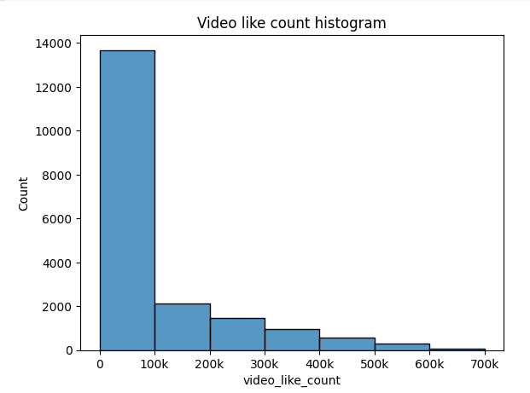
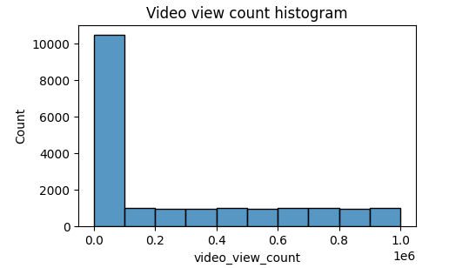
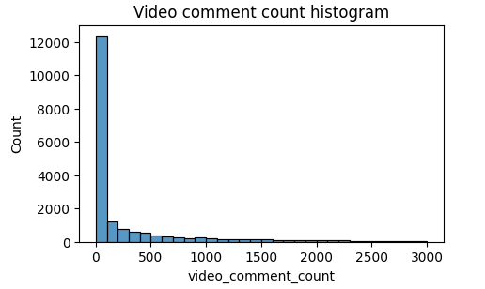
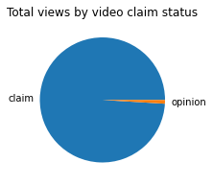
Executive Summary: Exploratory Data Analysis
TikTok Claims Classification Project
A key component of this project’s exploratory data analysis involves visualizing the data. As illustrated in the following histograms, it is clear that the vast majority of videos are grouped at the bottom of the range of values for three variables that showcase TikTok viewers’ engagement with the videos included in this dataset.
The TikTok data team seeks to develop a machine learning model to assist in the classification of claims for user submissions. In this part of the project, the data needs to be explored, cleaned, and structured prior to any model building.
The TikTok data team conducted exploratory data analysis at this stage. The purpose of the exploratory data analysis was to understand the impact that videos have on TikTok users. To do so, the TikTok data team analyzed variables that would showcase user engagement: view, like, and comment count.
More than half the videos received fewer than 100,000 views. Distribution of view counts > 100,000 views is uniform.
A majority of videos have < 100,000 likes, with the like count distribution being heavily right skewed.
Similar to like count, the vast majority of videos have fewer than 100 comments. The distribution is also very right-skewed.
According to the findings from the exploratory data analysis, the future claim classification model will need to account for null values and imbalance in opinion video counts and video engagement metrics in the model parameters.
The pie graph on the right demonstrates a major bias for view count in claim videos, accounting for over 99 percent of total views from videos in the dataset.
The exploratory data analysis conducted from TikTok’s data team revealed many considerations for the classification model, including missing values, “claims” to “opinions” balance, and overall distribution of data variables. The two key insights from this analysis were:
Null values
Almost 300 null values were found in 7 different columns. As a result, future modeling should consider the null values to avoid making insights that would assume complete data. Further analysis is necessary to investigate the reason for these null values, and their impact on future statistical analysis or model building.
Skewed data distribution
Video view and like counts are all concentrated on low end of 1,000 for opinions. Therefore, the data distribution is right-skewed, which will inform the models and model types that will be built.

